Slide 1

FINAL PROJECTS
COMPUTER INFORMATION TECHNOLOGY
CV RESUME
SPREADSHEET
ANALYZE

Slide 2
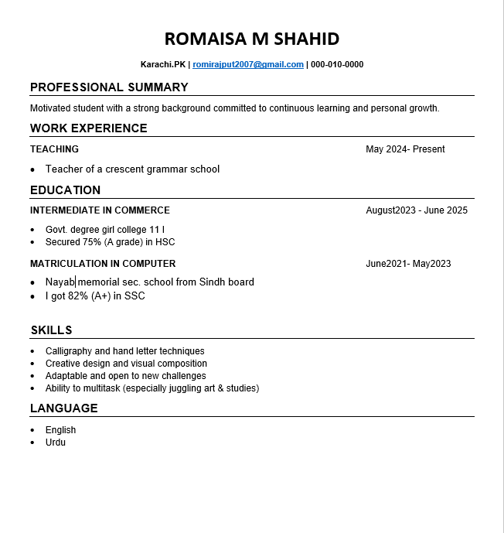
MY RESUME:
I made my resume using Microsoft Word. First I opened Word and chose a blank template. Then I filled in my personal summary, work experience, education, skills and language.
I used bullet points, clear fonts, and bold headings to keep it neat and professional. After checking for any mistakes, I saved it on my computer.
I’m really happy with how my CV turned out, it was easy to make and looks fantastic. Thank You!

Slide 3
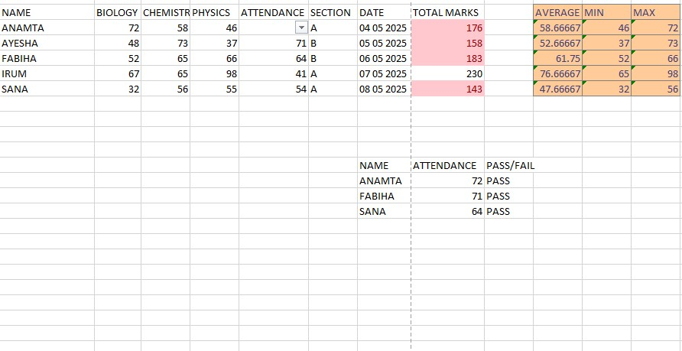
SPREAD SHEET
I have created a spreadsheet for students results. Using Microsoft Excel then I used the SUM formula to automatically calculate the total marks then I calculated the minimum marks scored by students in biology and chemistry papers using the MIN formula then I calculated the maximum marks scored by students in biology and physics papers using the MAX formula. Next, I used the VLOOKUP function to determine the attendance of three students then I applied the IF formula to determine pass or fail for three students. Then I used the AVERAGE function to find the average marks of all students in biology and chemistry. Microsoft Excel made it simple for me to generate and manage students’ results. Thank You!

Slide 4
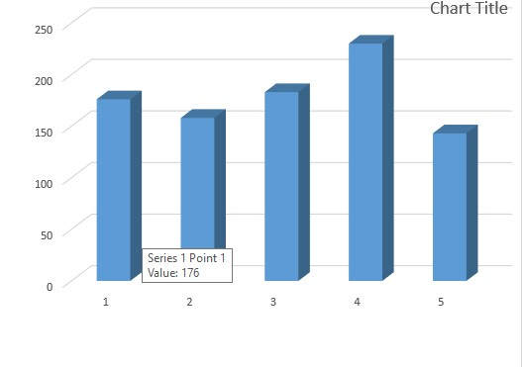
CHART
I created a chart in Excel to graphically represent the student’s total marks, making it easier to compare and analyze their performance.

Slide 5
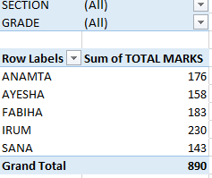
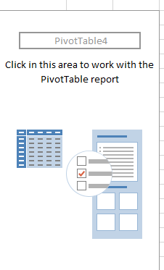
PIVIOT TABLE
I created a pivot table in my spreadsheet. It is used to summarize, analyze, and organize data. In a pivot table, we can use rows and columns arrange the data, values calculate totals or averages, and filters help[ to focus on specific information

Slide 6
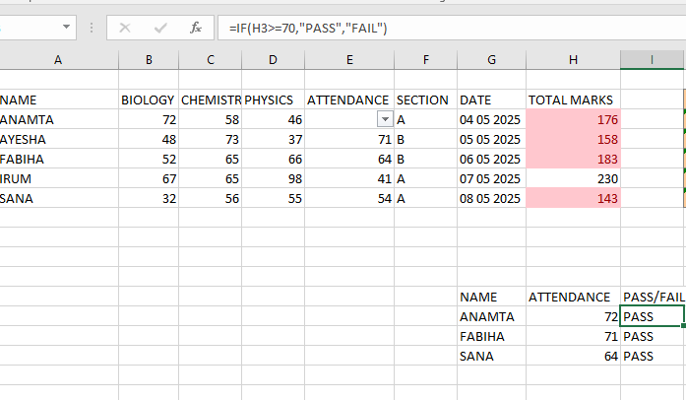
IF IN EXCEL
The IF formula is used to check a condition. If the condition is true, it gives one result, and if it is false, it gives another result

Slide 7
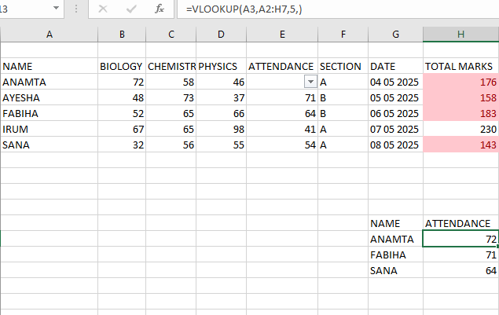
VLOOKUP IN EXCEL
VLOOKUP is used to search a value in the first column of a table and return a matching value from another column

